Slide 1
Treasure Map MSIT 516
Vinita Chinchwade
Brittney Elhard
Ernest Goodman
Shipra Jain
Greeshma Katam
Sowjanya Kunti
Sitanshu Mathukia
Tasmiya Mujawar
Xinwei Tang

Slide 2
Agenda
Project Overview
Technical overview
Demo of Game
Statistics of Game
Conclusion

Slide 3
Project Overview
What is a treasure map?
How does it work?
Technology used for development

Slide 4
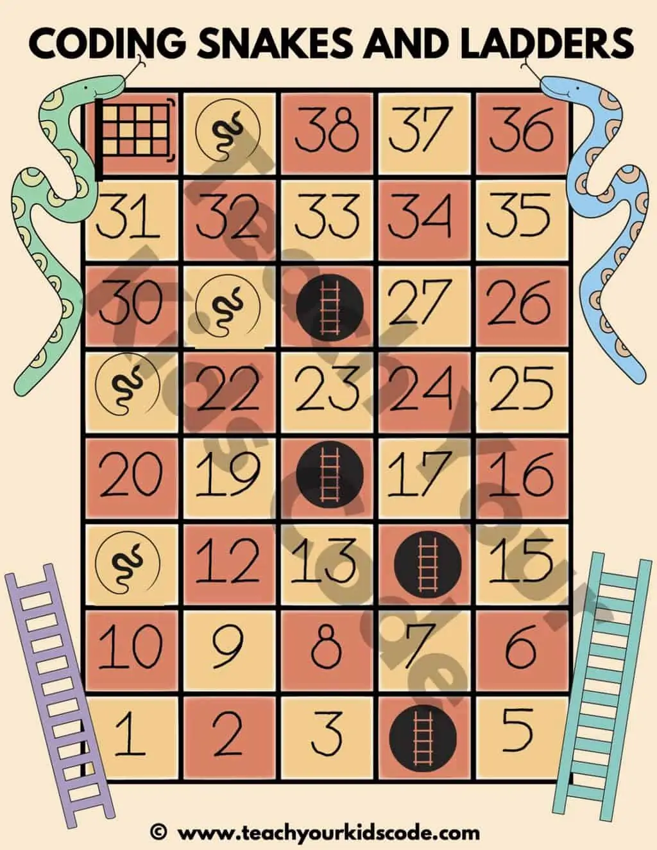
Similar Game
Snakes and ladders
Players need to follow the arrows in the algorithm to follow the snake or ladder
If they land on a snake, they move backwards.
If they land on a ladder, they advance.

Slide 5
Technical Overview:
Graphs
A graph is a type of data structure that holds a certain type of data. A graph G (or g) is defined as a collection of vertices (V) and edges (E) connecting the vertices.
There is a connection between each vertex and edge. Where the vertex represents the data and the edge the relationship between them. Vertex is represented by a circle with a label. Edges are represented by a line connecting two nodes (vertices).

Slide 6
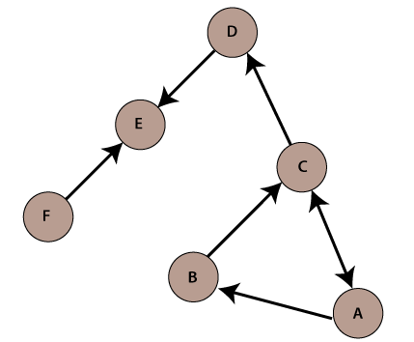
Technical Overview:
Digraph
In a directed graph, the edges express direction. We utilize arrows instead of lines in a directed graph (edges). The direction represents the path from one node to another.
In a directed graph, we can travel in either one or both directions.

Slide 7
Technical Overview:
In class and StdRandom
In class
Input class has methods for reading strings and integers from standard, file, URL, and socket input.
StdRandom
StdRandom provides static methods for generating random numbers from a variety of discrete and continuous distributions, including uniform, bernoulli, geometric, gaussian, exponential, pareto, poisson, and cauchy distributions.
It also includes a mechanism for shuffling an array or subarray, as well as generating random permutations.

Slide 8
Technical Overview:
APIs
The Treasure Map game is written in Java programming language with the use of princeton.cs.algs4 java extended library.
Our game program uses the following APIs:
edu.princeton.cs.algs4.Digraph
edu.princeton.cs.algs4.In
edu.princeton.cs.algs4.StdOut
edu.princeton.cs.algs4.StdRandom

Slide 9
Technical Overview:
nextMove
How our program works?
The program has method nextMove. The method uses several variables and iterates player positions with the use of the loop. The following is a part of program which contains nextMove method:
public static void nextMove(int player, int[] currSpace, int roll, Digraph di) { //Takes in player, their space, their roll, and digraph
int nodes = di.outdegree(currSpace[player]); //Stores current amount of out degrees at player space. (Always two)
int choice = StdRandom.uniform(0, nodes); //Picks a random number between zero or one before the loop. (zero = forwards and one = backwards)
for (int i = 0; i < roll; i++) { //Iterates through until it meets the size of the roll.
int[] choices = new int[nodes]; //Stores the two choices in an array (Always two as seen above)
int j = 0; //Used for increments
for (int a : di.adj(currSpace[player])) { //Uses the digraph iterator to give us the actual values of the out degrees.

Slide 10
Technical Overview
if (choice == 0) { //If the choice is zero(forward) the player will only go forward.
choices[j] = a;
j++;
} else if (choice == 1) { //If the choice is one(backwards) the player will only go backwards.
choices[j] = a;
j++;
}
currSpace[player] = choices[choice]; //Current space of the player = either forward or backwards. Will always be one way depending on the random number.
}
}
}

Slide 11
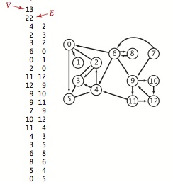
Technical Overview: Mapping
The program keeps game data inside the file map.txt.
We prepared the game data map.txt using the following input file format.

Slide 12
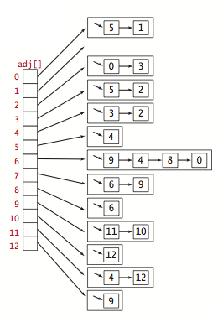
Technical Overview:
Graphs
Graph representation. We use the adjacency-lists representation, where we maintain a vertex-indexed array of lists of the vertices connected by an edge to each vertex.

Slide 13
Technical Overview
How our program works:
The following is a main method of the program:
public static void main(String[] args) {
int numPlayers = Integer.parseInt(args[0]); //Takes in one argument for amount of players.
if (numPlayers > 4 || numPlayers < 1) { //If a value lower than 1 or higher than 4 is entered the players will be randomly assigned between 1 and 4.
StdOut.println("Please Enter between 1 to 4 players.");
return;
}
In in = new In("map.txt"); //Input stream "in" to take in values for the digraph (41 vertices, 82 edges).
Digraph di = new Digraph(in); //Digraph "di" takes in the values from map.txt.
int[] points = new int[di.V()]; //Creates an array "points" that has 41 values (di.V() = 41 vertices).
for (int i = 0; i < di.V(); i++) { //Fills the array "points" with random points between 1 and 5 until each vertice is filled.
points[i] = StdRandom.uniform(1, 6);
//StdOut.println(points[i]);
}

Slide 14
Technical Overview
Our program records data from map.txt file into arrays.
The following is a main game loop:
//Main game loop
for (int i = 0; i < 1000000; i++) { //Loops up until 1,000,000. This number should never be reached.
int player = i % numPlayers; //Each loop the next player is up. 1 - 4.
playerTurns[(i % numPlayers)]++; //Keeps track of the players turns.
if (playerPoints[player] < winningPoints) { //If players current points is less than the winning points continue.
int die = StdRandom.uniform(1, 7); //Random die roll between 1 and 6.
dieRolls[(i % numPlayers)] += die; //Used to keep track of the average die roll per player.
StdOut.println("Turn #" + playerTurns[player]); //Prints turn number per player.
StdOut.println("Player " + (player + 1) + " rolls a " + die); //Prints current player and what they rolled.
nextMove(player, currentSpace, die, di); //Calls nextMove method
visitedSpace[currentSpace[player]]++; //Keeps track of most visited space.

Slide 15
Technical Overview
if (traps.contains(currentSpace[player])) { //If traps Arraylist = current space for player continue.
trapTotal++; //Tracks amount of traps hit.
playerPoints[player] = playerPoints[player] - 5; //Each trap is minus 5 points.
totalLost[player] = totalLost[player] - 5; //Tracks total points lost for each player.
StdOut.println("The player's gold was stolen by pirates! They lose 5 gold."); //Text to show traps was hit.
} else if (bonus.contains(currentSpace[player])) { //If bonus Arraylist = current space for player continue.
bonusTotal++; //Tracks amount of bonus hit.
playerPoints[player] = playerPoints[player] + 5; //Each bonus is plus 5 points.
totalGained[player] = totalGained[player] + 5; //Tracks total points gained for each player.
StdOut.println("The player found a pirate's chest! They gain 5 gold."); //Text to show bonus was gained.
}

Slide 16
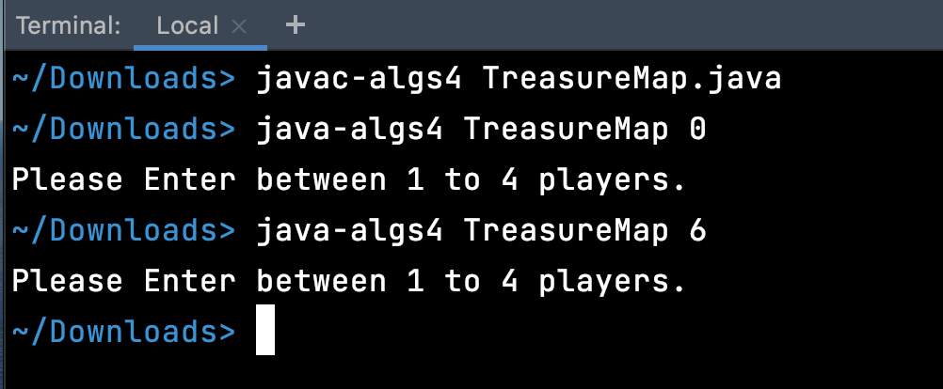
Exceptions

Slide 17
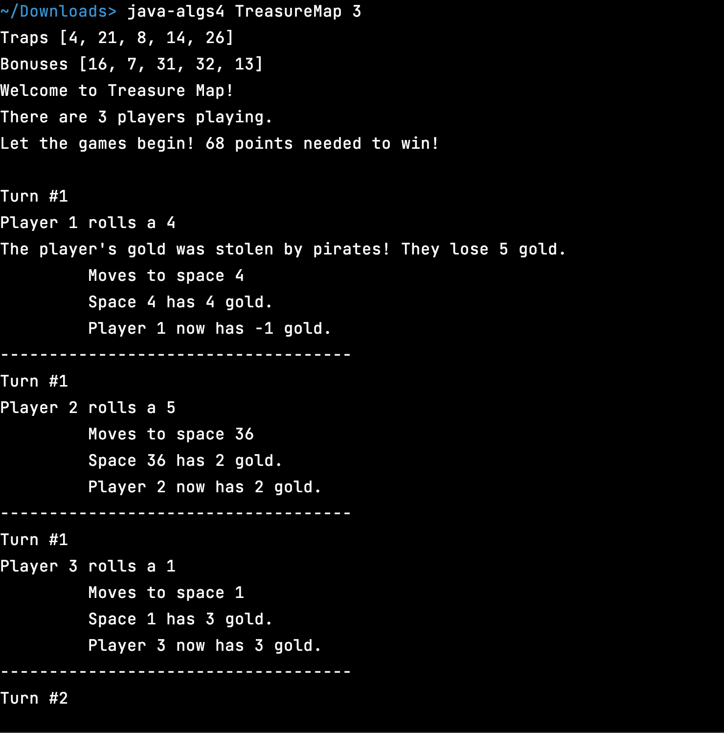
Terminal View

Slide 18
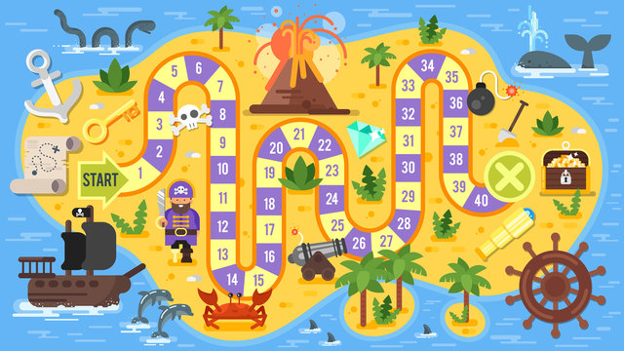
Demo

Slide 19
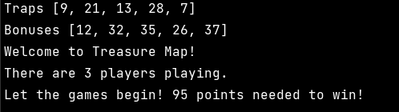
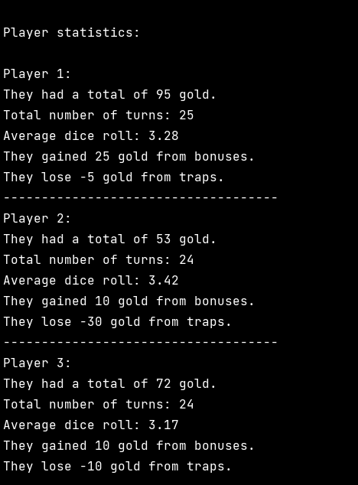
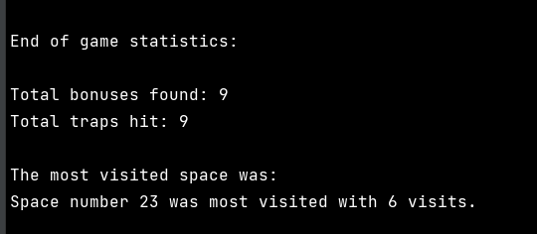
Statistics

Slide 20
Conclusion
Treasure Map
Graph & Digraph data types
Traps and bounces
Read text files

